Slide 1
Doctor Who?
ED Wait Time Predictor
Alyssa Harker, Amir Kazi and Tianchu Shu

Slide 2
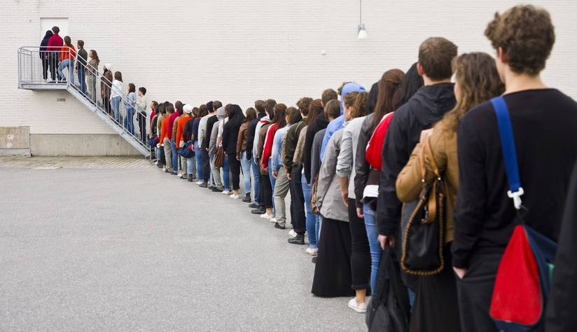

Slide 3
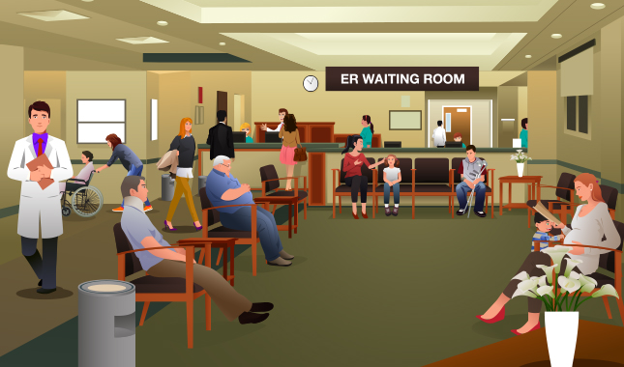
Introduction
People hate waiting
Project Goal: predict wait time for five closest hospitals and current driving time to those hospitals
Notes:
especially when they do not know how long they will have to continue waiting. We want to help people know which hospital’s emergency department they should choose in order to minimize their wait time. The patients can then have realistic expectations for how long they may wait. Our goal is to give a potential patient the following information: average wait time for being seen by a medical professional in the emergency department for a given hospital, travel time to arrive at the given hospital, a predicted wait time that is calculated based off of the average wait time as well as the current time, day of the week, and current temperature, and a rating for the hospital overall. We will then show the patient this information for the five closest hospitals sorted by total travel and predicted wait times.

Slide 4
Final Product
Website:
User enters zip code
Lists 5 closest hospitals by fastest total time
Total time = Predicted wait time + Travel time
Enter your Zip Code:
60637
Fastest Hospital
Total Time: 45 min
Predicted wait time*: 30 min
Travel time: 15 min
Rating: 4/5
_____________________
*Based off average wait time: 15 min
2nd Fastest Hospital
Total Time: 55 min
Predicted wait time*: 40 min
Travel time: 15 min
Rating: 3/5
_____________________
*Based off average wait time: 20 min
3rd Fastest Hospital
Total Time: 57 min
Predicted wait time*: 32 min
Travel time: 25 min
Rating: 4/5
_____________________
*Based off average wait time: 17 min
4th Fastest Hospital
Total Time: 68 min
Predicted wait time*: 40 min
Travel time: 28 min
Rating: 5/5
_____________________
*Based off average wait time: 20 min
5th Fastest Hospital
Total Time: 70 min
Predicted wait time*: 50 min
Travel time: 20 min
Rating: 2/5
_____________________
*Based off average wait time: 32 min
Notes:
RATING

Slide 5
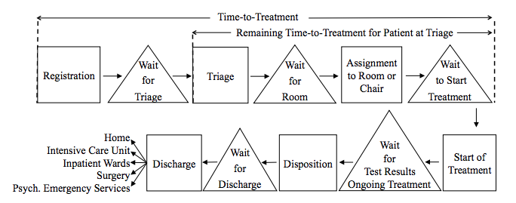
Databases: Wait Time Averages
Ang et al. 2015
Medicare.gov: Hospital Compare
Timely and Effective Care - Hospital
average wait time for being seen by a medical professional in the emergency department
Hospital General Information
location, contact information, as well as ratings of hospitals.

Slide 6
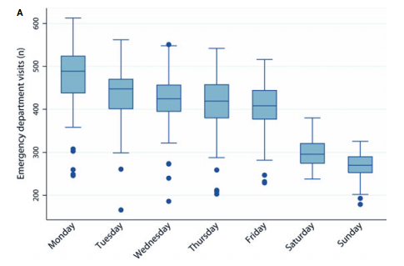
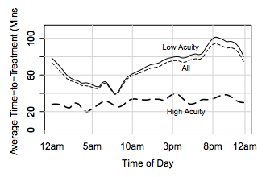
Databases: Predicting Wait Time
Ang et al. 2015
Marcilio et al. 2013
National Hospital Ambulatory Medical Care Survey Data (NHAMCS)
ED visit data including wait time, time of day, and day of the week
Use this data to calculate how time and day of the week affect wait time

Slide 7


APIs
Weather Underground API
current weather
historical temperatures
Google Maps API
Calculate current driving time to the 5 closest hospitals

Slide 8
Summary
Goal: Give potential patients more information about choosing an Emergency Department
Databases: Medicare.gov’s Hospital Compare and National Hospital Ambulatory Medical Care Survey Data
APIs: Weather Underground and Google Maps
Final product: website displaying information for the five closest hospitals sorted by fastest total time
Notes:
Patients can use travel time, predicted waiting time, and rating to choose the best hospital

Slide 9

THANK YOU!
ANY QUESTIONS?

